Slide 1

Data Analyst Job MARKET
Website Development
Project 3
10/9/21

Slide 2

Introduction
Team
Technologies/Data Source
Project Overview
Development Process
Website
Summary

Slide 3

Introduction
So You Are Looking For A Data Analyst Job?
The pandemic resulted in many people losing and looking for jobs. The Data Analyst Job Search Website makes it possible to target your job search based on:
Location
Salary
Sector

Slide 4





Technologies/Data Source
Kaggle Dataset – Data Analyst Jobs
2253 job listings scraped from Glassdoor
Created 7/14/2020

Slide 5




Meet The Team
MICHELLE DAVIS
YUQING HUANG
DAWN WASHINGTON
CODY GARDNER

Slide 6

Project Overview
Clean the Kaggle Dataset
Create Visualizations – Python, Plotly
Create Webpages - HTML/CSS
Load Website - GitHub Pages
Let’s Dive In

Slide 7
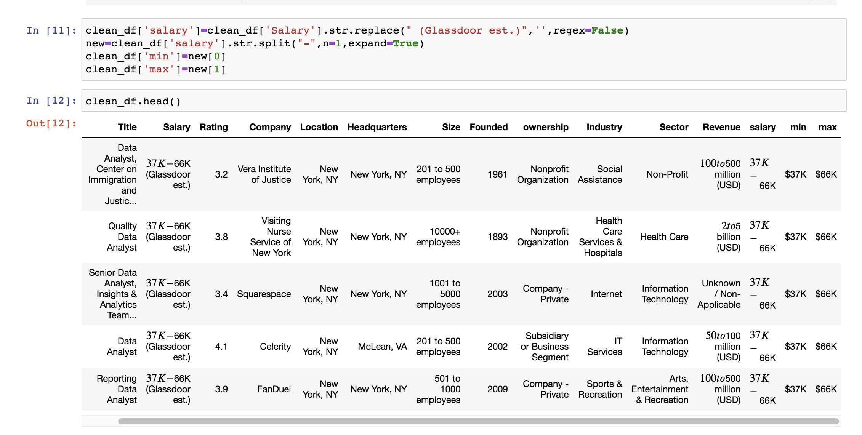
Data Cleaning

Slide 8
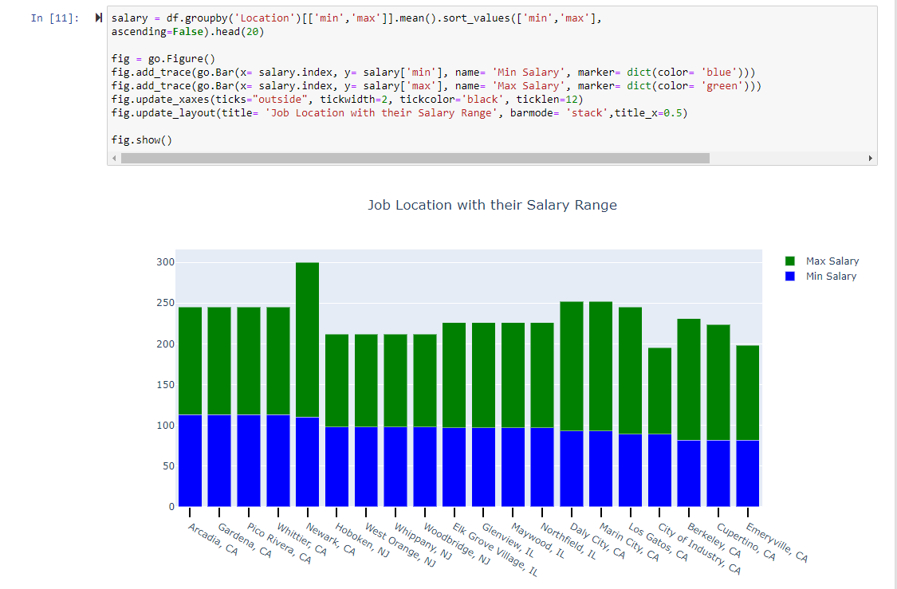
Create Visualizations

Slide 9
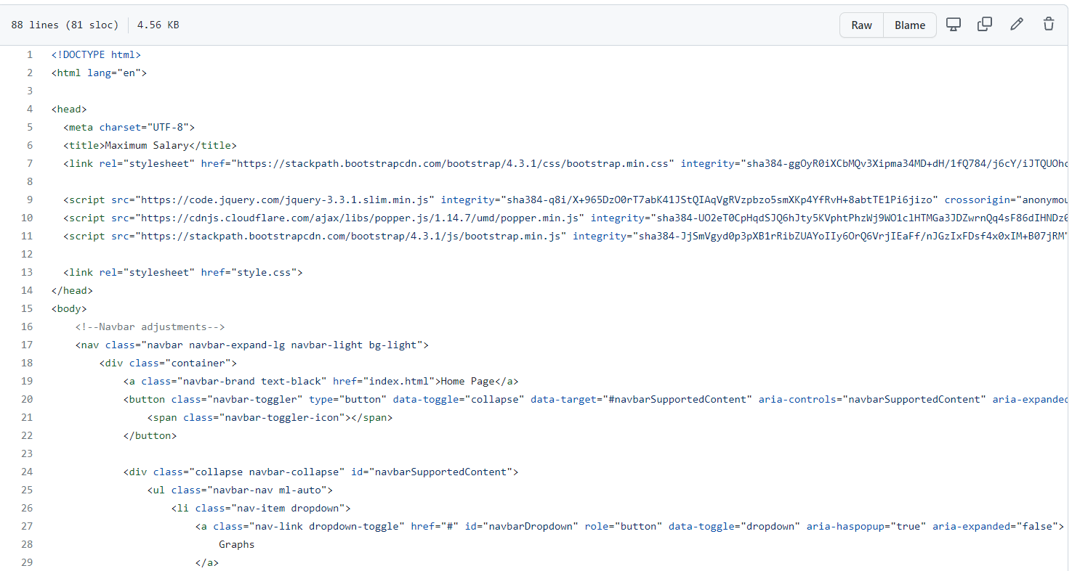
Create Webpages

Slide 10
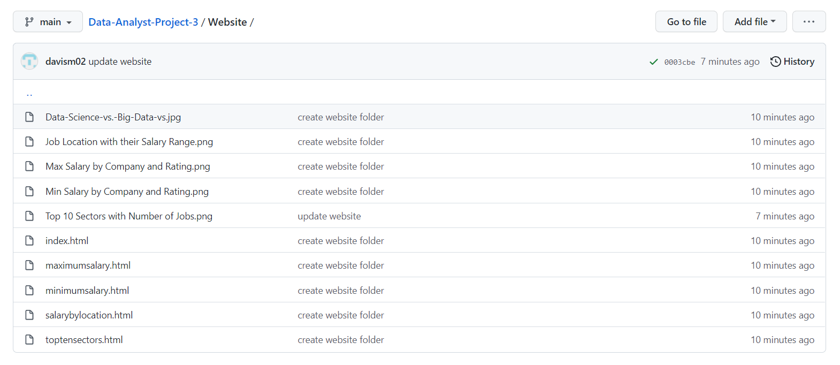
Deploy GitHub Pages

Slide 11

Data Analyst Job Market
https://davism02.github.io/Data-Analyst-Project-3/Website/index.html

Slide 12

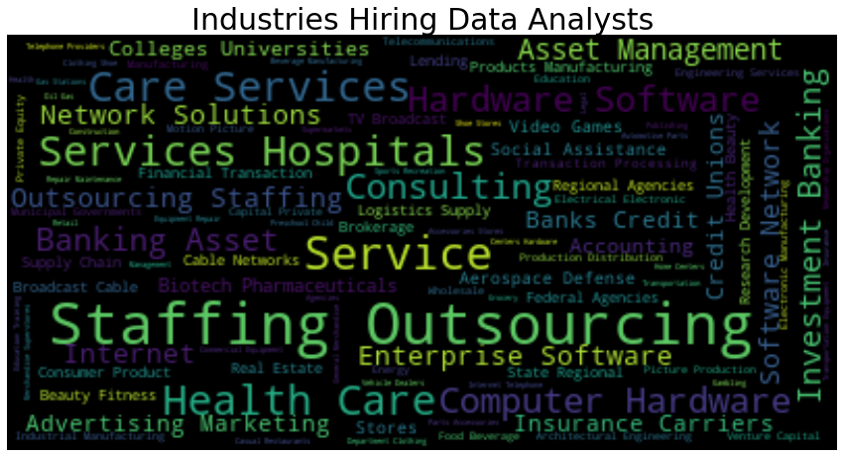

Slide 13
THANK YOU

